Slide 1
IBM HR Analytics : Employee Attrition and Performance
Presented by: Shahla Liaquat
Last Updated : July 8th , 2024

Slide 2
Table of Contents
Employee Attrition and Performance
→ Using data analytics to understand employee attrition and performance
for better workforce management
→ Telling the Story with Data
→ Insights and Recommendations

Slide 3
Objective
Analyze and understand employee attrition and performance using IBM HR Data.

Slide 4
Dataset Overview
There are 1470 rows and 35 columns of data
Key attributes in this dataset include:
Age
Attrition
Gender
Monthly Income
Total Working Years
Years at Company

Slide 5
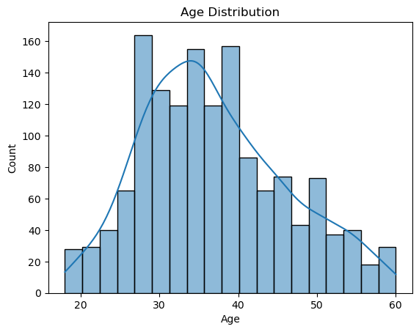
Age Distribution

Slide 6
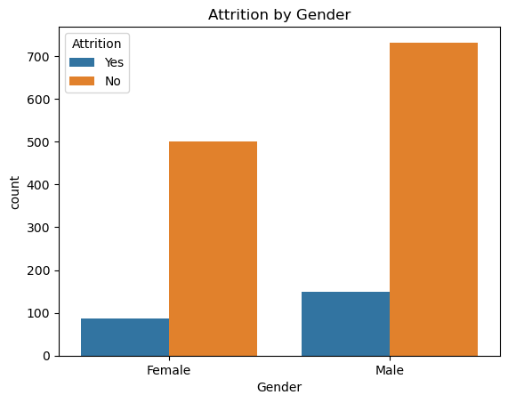
Analysis of Attrition
Overall Attrition rate is 16.12%
The chart indicates that more males than
females are employed, and the attrition
rate among males is higher.

Slide 7
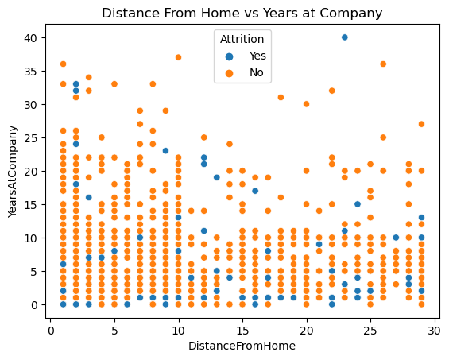
Factors Influencing Attrition
Key Factors :
Distance from home
Years at Company
Insights :
Employees who live closer to the workplace
tend to stay longer with the company.

Slide 8
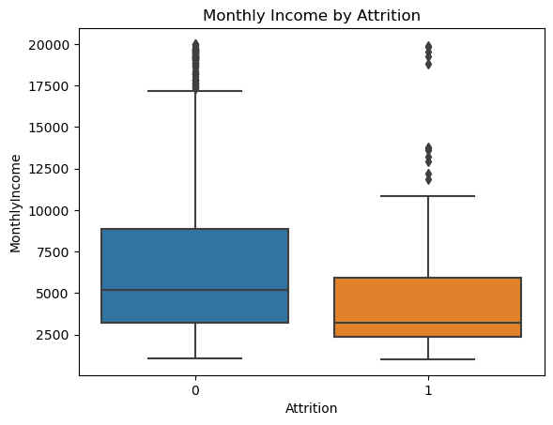
Monthly income
Attrition
Insights:
Employees who left the company
(attrition) tend to have lower
Monthly incomes compared
to those who stayed

Slide 9
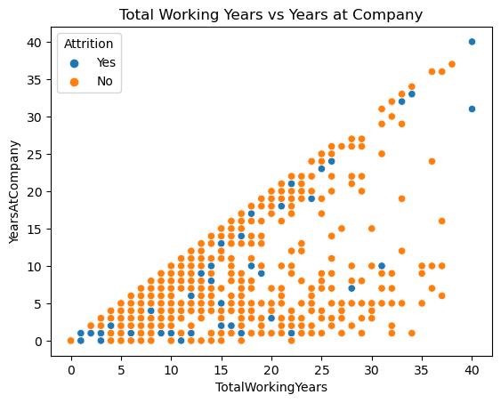
Total Working Years
Years at Company
Insights :
Employees with more total working
years tend to have spent more years
at the company. However, there are
cases of attrition among both new
and experienced employees

Slide 10
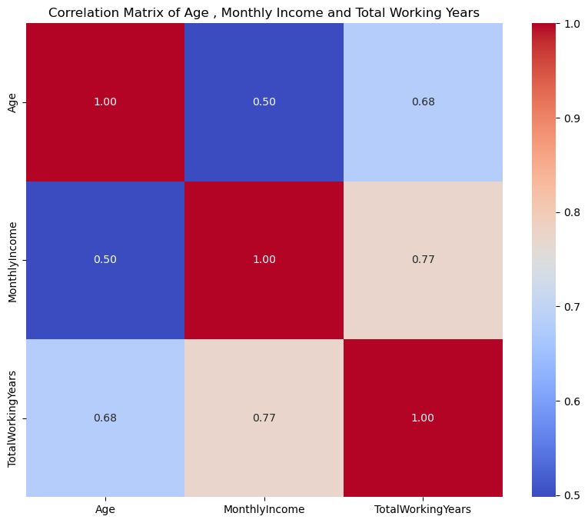
Correlation Analysis
The correlation matrix heatmap
visualizes the relationships
Between three key variables:
Age, Monthly Income, and
Total Working Years.

Slide 11
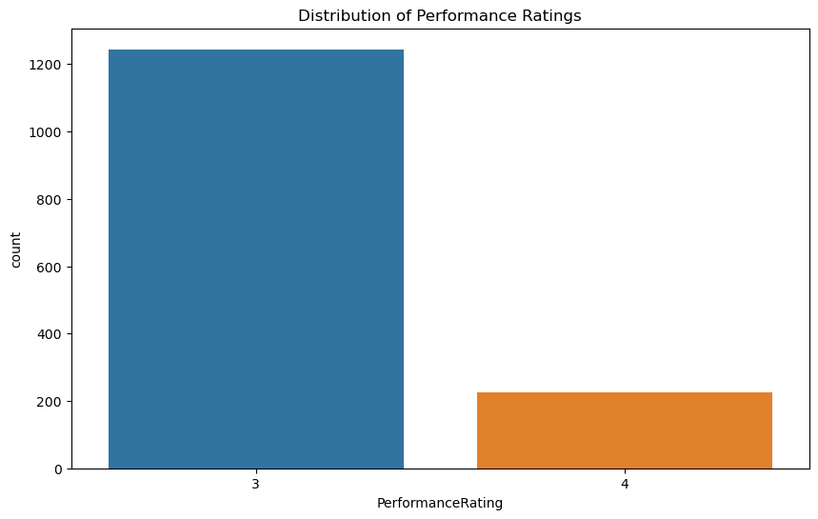
Performance Evaluation

Slide 12
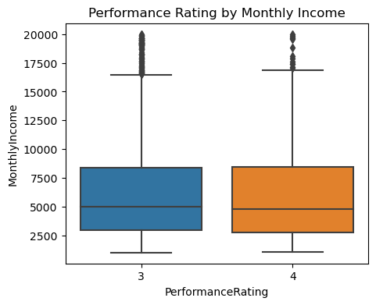
Performance Evaluation

Slide 13
Insights
Peak around ages 30-40, decline beyond 40.
Higher attrition rate among males compared to females.
Higher age correlates with higher income with correlation (0.50)
Employees living closer stay longer.
More working years correlate with longer company tenure with
strong correlation (0.68)

Slide 14
Monthly Income & Total Working Years: Very strong positive correlation (0.77).
Lower income for employees who left vs. those who stayed.
Majority of employees rated 3, fewer rated 4.
Significant difference in count between ratings.
Similar median monthly income for ratings 3 and 4.

Slide 15
Recommendations
Focus retention strategies on employees in their 30s and 40s.
Investigate and address reasons for higher male attrition.
Ensure competitive compensation across age groups.
Implement flexible or remote work options for distant employees.
Enhance onboarding and career progression plans.
Adjust compensation to reflect experience value.
Foster career growth to increase earning potential.
Focus on retaining experienced staff with competitive pay.
Introduce performance-based incentives.

